Slide 1
Igniting the AI Fire in You (carefully)
Apoorv Vikram Singh
Project Associate at CSA

Slide 2
Press Coverage of AI: two threads
Notes:
Popular press coverage: 2 separate threads.
Thread 1: Success stories.

Slide 3
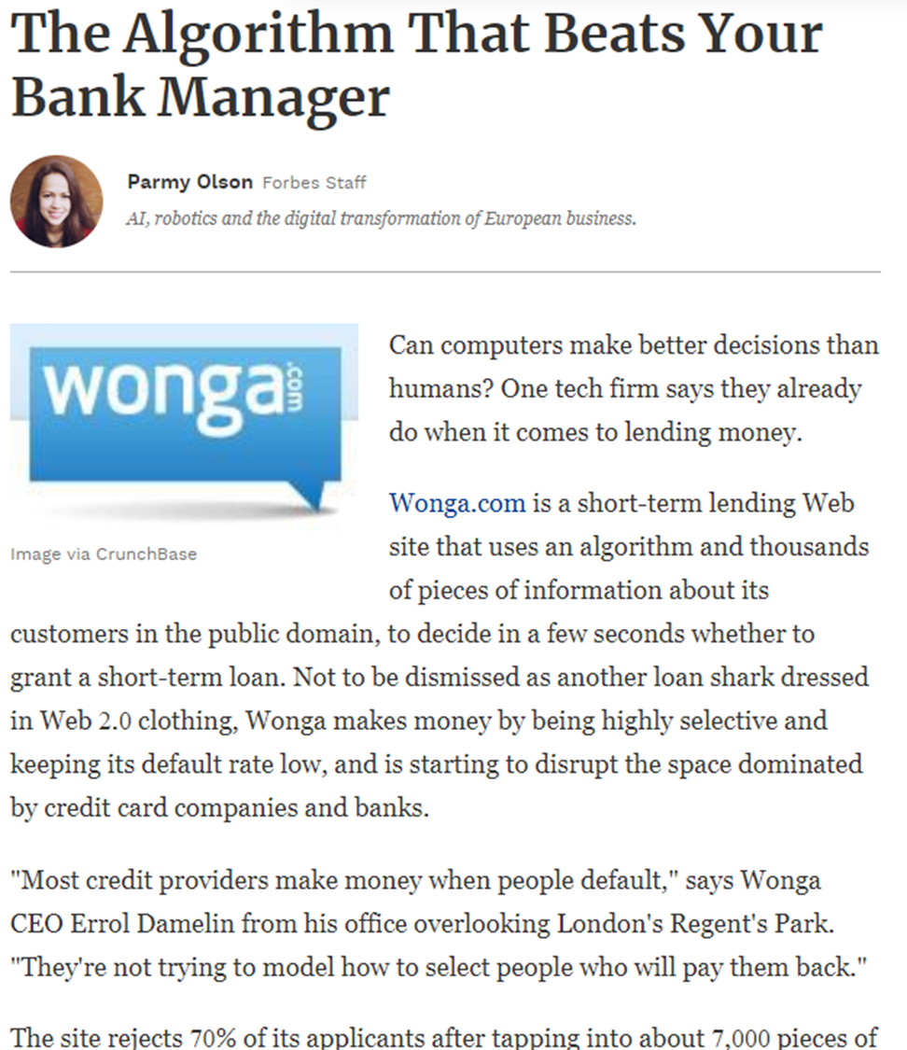
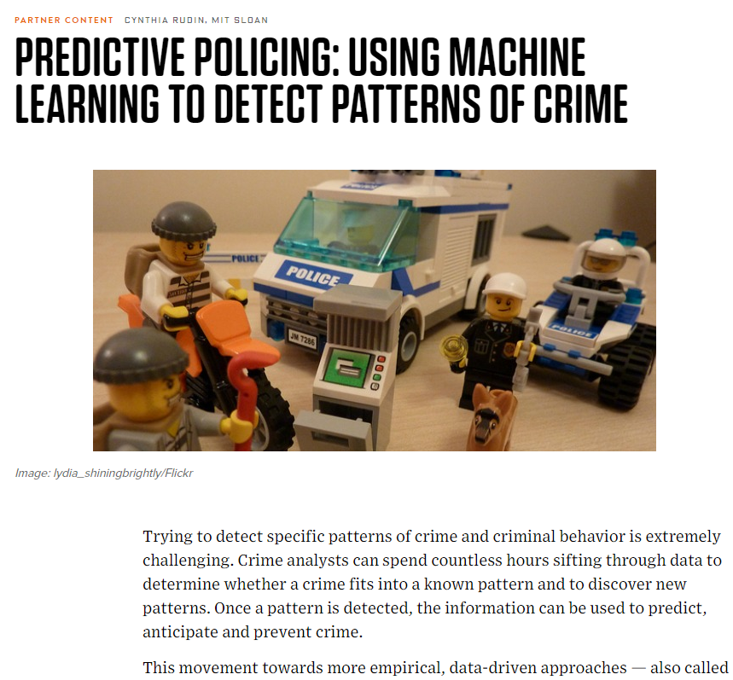
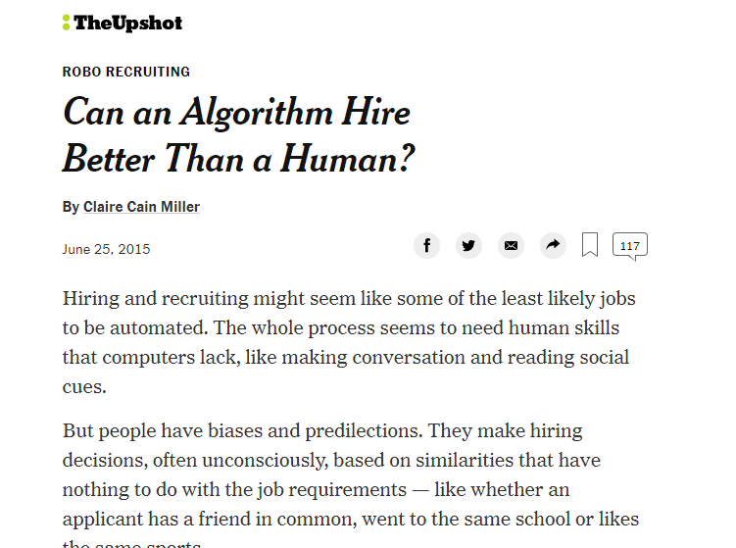
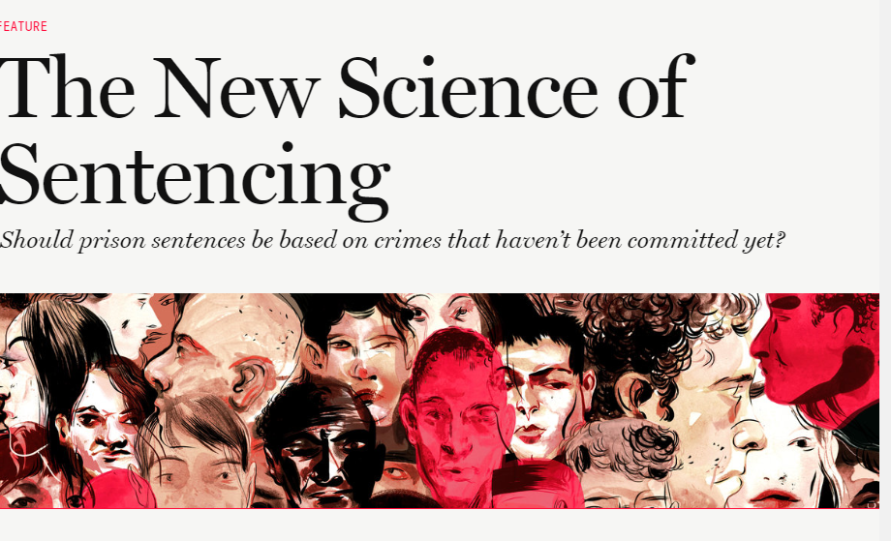
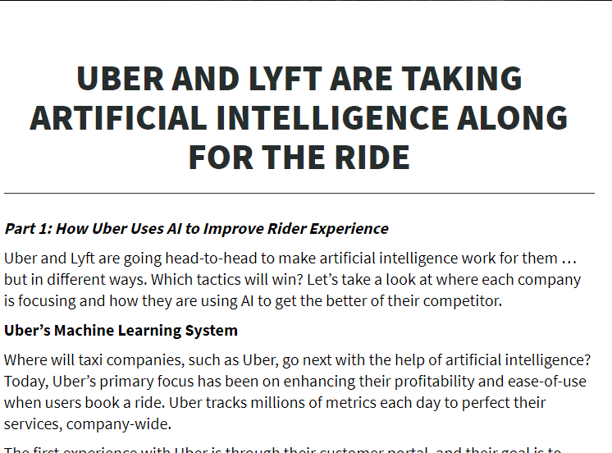
Notes:
Use ML to improve aspects of daily life. Spam filtering, hiring, credit risk, matching driver to riders, criminal justice system, where to send police officers. We train algorithm on personal sensitive data to make decisions. No surprise it suggests the other thread.

Slide 4
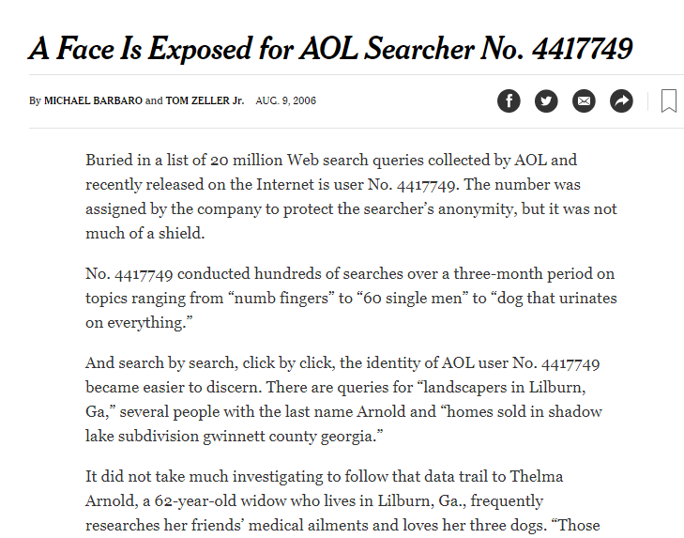
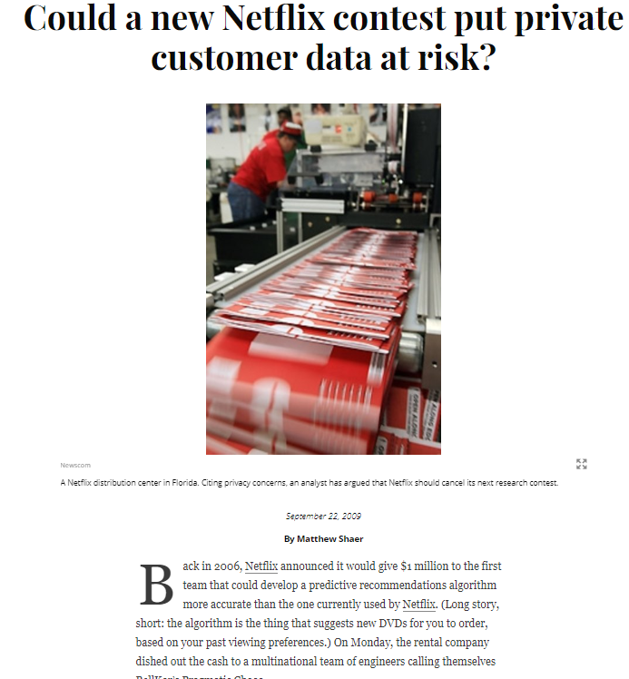
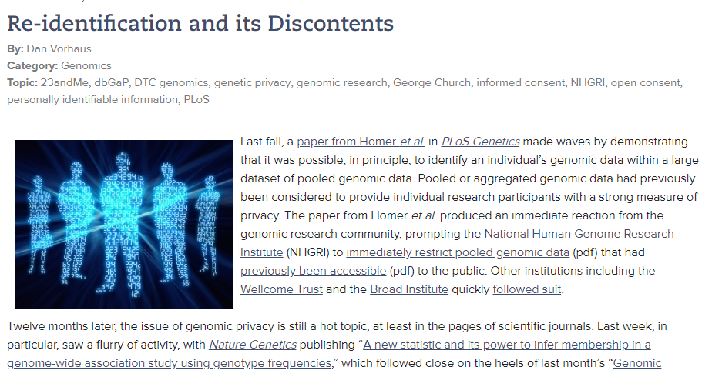
Notes:
Thread 2: Worries- violations of social norms we hold dear. Sensitive data about people, and fairness. They are perpetuating human biases or introducing new ones at scale.
The second thread is worrying that algo violate the social norms we hold dear, like user privacy or fairness.
Today we will focus mostly on how to fix the second thread. If we are going to replace components of decision making, which was historically done by humans, then we need to be able to encode the social norms like privacy, fairness which we expect the human to respect.
We need ethical algorithms.

Slide 5
Ethical Axe?
Notes:
A natural question arises: one would be sceptical speaking about ethical algorithms. Like an axe, an algorithm is a human artefact, and we don’t blame the axe for causing harm, we blame the human who used the axe for unethical purposes. So why demand the same from algorithms?

Slide 6
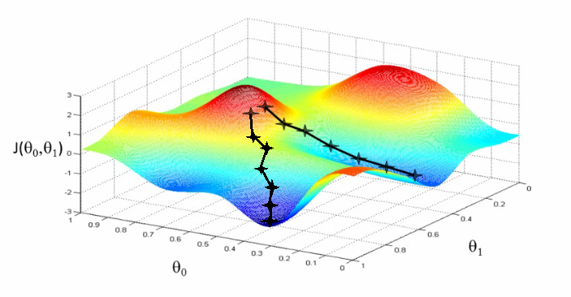
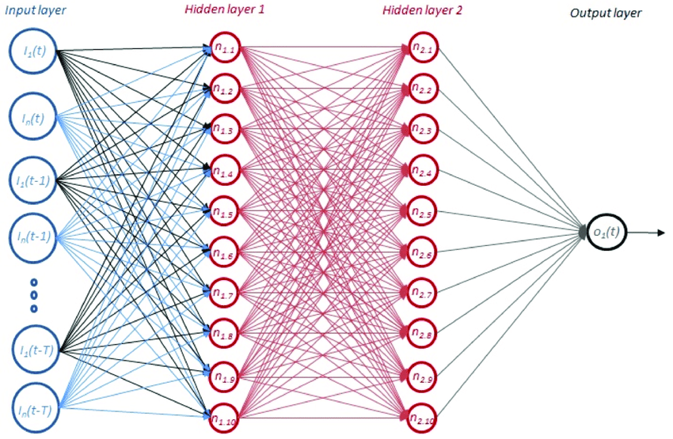
Algorithms: hard to assign the blame
Notes:
Assert: same is not the case with algorithms
They start with large data (which we don’t necessarily understand). Then with the data, we use some training procedure like gradient descent for a particularly chosen loss function. Even if you know about GD very well locally, it doesn't mean you understand the model it produces. If the model then harms someone, then can’t put moral blame on the coder. The coder can’t predict every consequence of the algorithm when it is deployed.

Slide 7
Evil Programmers?
Notes:
It’s not like there were evil programmers dead-set on making racist algorithms or privacy-violating algorithms. It would be easy if that were the case. We have justice system in place to deal with that kind of malfeasance.

Slide 8
Need to embed social values in the algorithm
This requires being precise about definitions, and then developing their consequences.
Privacy
Fairness
Accountability
Interpretability
Morality
Notes:
We need to embed these in the algorithm as a constrained optz problem. However, these words mean various things to various people. For instance, the definition of privacy may mean something different to people sitting in the back of the class, than to people sitting in the front row.
Main problem: thinking very HARD and PRECISELY about definitions, trying to distil these vague English words into precise constraints.
Privacy: social value, which we have made a good progress on. I will briefly tell a bit about it.

Slide 9
Privacy: A success story
In brief
After many years of ad-hoc approaches and privacy breaches, a mathematical definition with meaningful semantics: differential privacy.
A decade of academic work, deriving out tradeoffs between privacy and inference ability, and developing practical algorithms.
In last several years: acceptance, wide deployment: Google Chrome, iOS10, US 2020 Census.
Doesn’t capture everything we mean by privacy, but lets us meaningfully discuss different kinds of privacy.
Doesn’t take a stand on how we should trade off accuracy, and privacy: it provides a framework to have the discussion in.
Notes:
Many ad-hoc definitions were proposed and deployed, and which followed by privacy breaches. For an object that you might publish, here is a test if the object is privacy preserving or not. Typically did not work.
Until 2005, differential privacy: had a strong semantic meaning. Started in TCS community. Differential Privacy: Learning and inference, subjected to information theoretic constraints.
Scientific study of differential privacy is about studying trade-offs.

Slide 10
Fairness
A work in progress
=
Exciting time to be thinking about it!
Notes:
It is at a stage where differential privacy was about 10 years ago.
There are set of mutually exclusive definitions, and no widely agreed upon definition: still nice thing as it lets us talk about different kind of fairness.
Let us see why would an algorithm be unfair?

Slide 11
The AI Algorithm
Need 2 things to build an algorithm:
1. Data (what happened in the past)
2. A definition of success (the thing we are looking for or hoping for)
Algorithm asks: what is associated with success? what situation leads to success?
Opinions get embedded in the code:
Algorithm ≠ Objective, True, and Scientific.
Notes:
Our implicit biases get embedded in the code. Our past data as well as our success belief. I want to emphasize on the fact that algorithms are not necessarily objective, true, and scientific.

Slide 12
A Thought Experiment
Notes:
Imagine a fully racially segregated society, where we send cops cars to only to the yellow neighbourhood. The arrest data would be highly biased. Now, we catch a random data scientist to build a model to predict where the next crime would happen? Or predict who the next criminal would be? Ans: A yellow person.
Data scientist now goes on to brag about how great his model worked, 99% accuracy, etc.
But this violates our social norms.

Slide 13
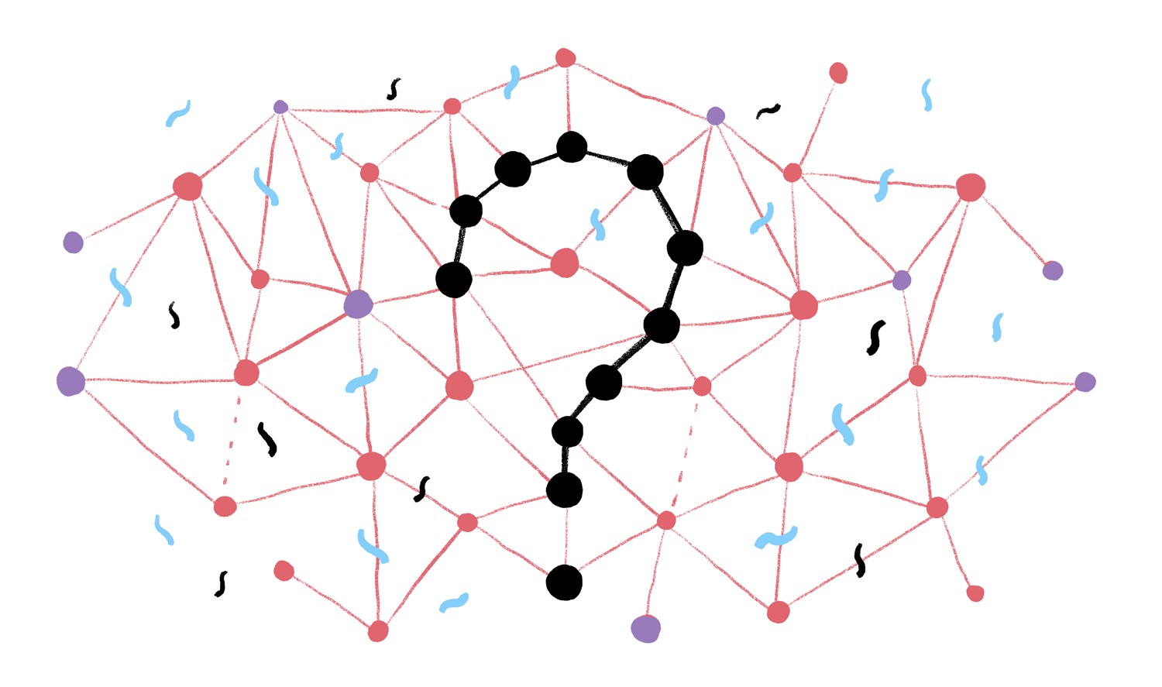
Example: AI hiring at a (historically) misogynistic company
Definition of a successful candidate: Stayed in the company for at least four years. Got promoted at least once.
Data: Last 30 years of employee performance.
REJECTS FEMALES

Slide 14
How to tackle this?

Slide 15
Seemingly Obvious Solution
Remove certain data attributes which the algorithm can use for discrimination, like sex, race, etc.

Slide 16
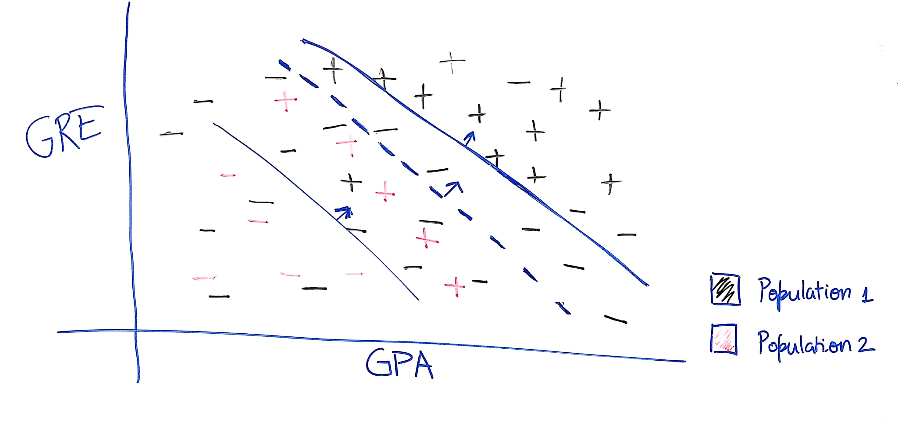
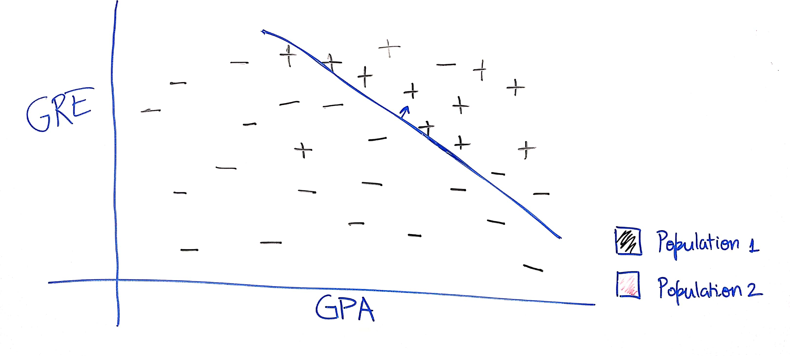
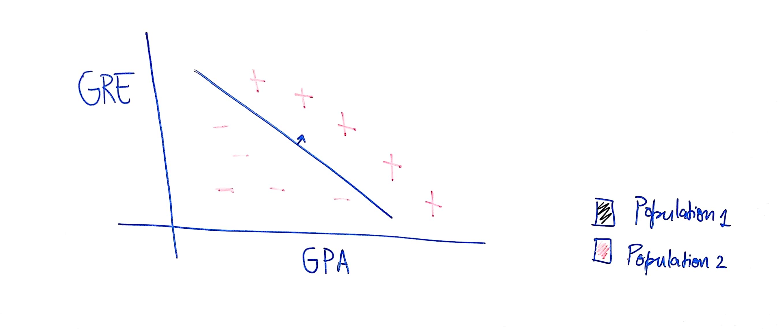
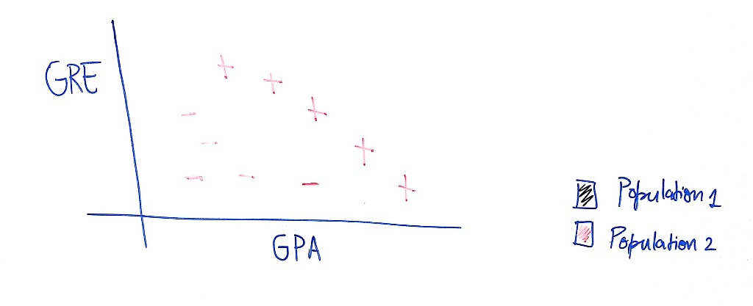
The Problem: toy example
Notes:
Better to use the gender information, else majority gets benefitted at the cost of the minorities.

Slide 17
Lesson Learnt:
Optimizing for average error fits the majority population
Can obtain Pareto improvements by using group membership.

Slide 18
Why was the classifier “unfair”?
Question: Who was harmed?
Possible Answer: The qualified applicants mistakenly rejected.
False Negative Rate: The rate at which harm was done.
Fairness := Equal false negative rates across groups?

Slide 19
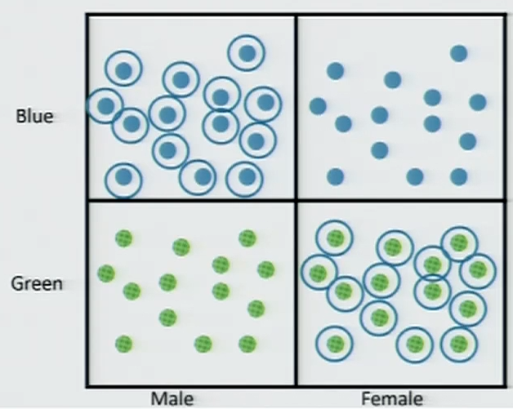
But… not quite what we wanted
Example: Protected subgroups: “men”, “women”, “blue”, and “green”.
The following allocation equalizes the false negative rate across all four groups:
Notes:
Admit everyone who is either a blue man or a green woman. Unfairness is packed. FNR is equalized. Cold comfort if you are a green male and blue female.

Slide 20
The Problem
A classifier equalizes the false negative rates. What does it promise you?
The rate is FNR assumes that you are a uniformly random member of your population
If you have a reason to believe otherwise, it promises you nothing!
What we really wanted:
$$∀ examples \left(x_{1}, +\right), \left(x_{2},+\right):Pr\left[f\left(x_{1}\right)=−\right]=Pr[f\left(x_{2}\right)=−]$$
A kind of individual fairness.
Notes:
Classifier shouldn’t favour any one individual over the other for no reason whatsoever. The randomness is over the classifier. Unless we make some unrealistic assumptions about the data, we cannot satisfy definitions like these.

Slide 21
A Middle Ground
First Attempt: Equalize FNR across a small number of coarsely define groups.
Easy to do/verify.
But doesn’t promise much.
Ideal: Equalize FNR across all “groups” of size 1.
Middle Ground: Equalize FNR across a huge number of finely defined subgroups.
Notes:
Observation: it is still sensible to ask FNR over infinitely many groups,

Slide 22
Interpolating between the two attempts
Still sensible to ask for fairness in huge number of “structured” sub-groups of moderate size.
E.g. Conjunctions on d attributes: $2^{d}$such subgroups.
A classifier $h∈H$ satisfies $γ$-False Negative Parity w.r.t. a class of group indicators $G$ if for all $g∈G:$
$$\underset{(x,y)}{Pr}\left[g\left(x\right)=1, y=1\right]⋅|\operatorname{Pr}\left[h\left(x\right)=0 \right| y=1] −\operatorname{Pr}\left[h\left(x\right)=0\right|g\left(x\right)=1,y=1] | ≤ γ$$
Size of positive population
False negative disparity
Notes:
Turns out that such a definition makes sense. Now we have many constraints of this form. You guys will learn techniques for that in IISc.

Slide 23
Experiments: the kind of curve we want
Notes:
We want these steep curves. Increase fairness at mild cost for fairness. It’s a data-set to data-set thing.

Slide 24
Takeaways
We should be precise about definitions.
Don’t need to capture everything we mean by “privacy”, “fairness”, etc. but helps clarify our thinking about what we mean.
Once we fix a definition, we need to explore tradeoffs.
Generally we can’t have it all.
The scientific problem is to determine Pareto curves, not to choose points on those curves.
The science is new and unsettled. An exciting time to think about these problems
Many other things of social values need to be defined: interpretability, accountability, morality, etc.

Slide 25
Thanks!

Slide 26
References:
This talk was a close approximation to the talk given by Aaron Roth:
https://www.nyas.org/news-articles/academy-news/making-moral-machines/
Some examples were used from Cathy O'Neil’s talks:
https://www.ted.com/talks/cathy_o_neil_the_era_of_blind_faith_in_big_data_must_end?language=en

